Slide 1
使用机器学习模型 Using Machine Learning Models
Microsoft Reactor | Chia-Chi Chang
#ReactorLOCATION

Slide 2
張家齊 Chia-Chi Chang
CEO 木刻思股份有限公司

Slide 3


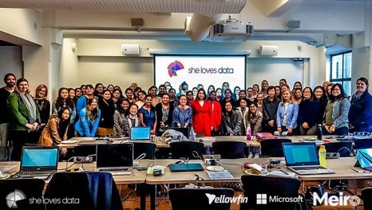

developer.microsoft.com/reactor/
@MSFTReactor on Twitter
Notes:
Welcome to your <location> Microsoft Reactors. We are worldwide local community spaces where developers and startup leaders meet, learn, and connect. Reactors build a diverse community by providing training, learning paths, industry speakers, and seminars, plus meetups and other community events related to emerging technology trends.
Reactor learning, networking, and leadership opportunities are designed to focus on real-world challenges to enable members of the tech community to stay up to date and drive solutions. Reactors are a place to share knowledge and expand impact in the company of technology enthusiasts locally and globally.
We have workshops and other learning opportunities planned throughout the year. Or if you want to host your own event at a Reactor, you can make the request on our website.

Slide 4
ML1 ML2 On-line Workshop Agenda ML1 ML2在线研讨会议程
Day 1 第一天 |  | Day 2 第二天
19:30 | Welcome 开场 | 19:30 | Welcome 开场
19:35 | Unsupervised Learning and Clustering: K-means 非监督式学习与分群算法：k-means 为例 | 19:35 | Supervised Learning and Classification: Regression 监督式学习与分类算法：回归分析 为例
20:05 | k-means ipynb LAB k-means 实作 LAB | 20:05 | Regression ipynb LAB 回归分析 实作 LAB
20:25 | 5-min breaks 中场休息 | 20:25 | 5-min breaks 中场休息
20:30 | Supervised Learning and Classification: Naive Bayes 监督式学习与分类算法：朴素贝叶斯 为例 | 20:30 | Introduction to Azure ML Studio Azure ML Studio 说明
21:00 | Naive Bayes ipynb LAB 朴素贝叶斯 实作 LAB | 20:45 | Azure ML LAB Azure ML 实作 LAB
21:20 | Q&A 问答 | 21:00 | The Weakness of ML Models in Real World and How to overcome? 机器学习在应用中的盲点与突破
21:30 | Event End 课程结束 | 21:20 | Q&A 问答
 |  | 21:30 | Event End 课程结束
Notes:
19:30 Opening 開場 19:35 Supervised Learning and Classification: Regression 監督式學習與分類算法：回歸分析 為例 20:05 Regression ipynb LAB 回歸分析 實作 LAB 20:25 中場休息 5-min breaks 20:15 Introduction to Azure ML Studio Azure ML Studio 說明 20:30 Azure ML LAB Azure ML 實作 LAB 21:00 The Weakness of ML Models in Real World and How to overcome? 補充教材：機器學習在應用中的盲點與突破 21:20 Q&A 問答與補充 21:30 Event End 課程結束

Slide 5

Notes:
Data defines the world around us. The combination of mountains of data and computing that is both powerful enough and economical enough to make sense of that data has led to huge breakthroughs in science, medicine, and the consumer technologies that we now take for granted. But for all the advances that the data revolution has made, it is still held back by a resource shortage: people; specifically, people with technical skills in data science who can navigate this growing field and help explain discoveries in it to others.
For example, we might be able to:
- Assist doctors with detecting tumors on an MRI scan that might otherwise be too small to be noticed at first
- Help farmers increase their crop yields and use fewer resources like water and fertilizer
- Help a person who is blind identify people or obstacles in front of them
- Reduce defects in the manufacturing process
The video we watched shows the power and affordability of big data processing on cloud platforms like Azure. DNA sequencing analysis is a form of life-sciences research that has the potential to lead to a wide range of medical and pharmaceutical breakthroughs. However, this type of analysis requires supercomputing resources and big data storage, which many researchers have lacked before now. Working through a grant provided by the National Science Foundation in partnership with Microsoft, a team of computer scientists at Virginia Tech addressed this challenge by developing an on-demand, cloud-computing model using data & analytics services. By moving to an on-demand cloud computing model, researchers now have easier, more cost-effective access to DNA sequencing tools and resources, which could lead to even faster, more exciting advancements in medical research.
This workshop is about bridging the shortage of practitioners with technical skills in data, particularly in data science. Everyone should care about data science; you are here today because you are choosing to act to gain more information and skills in this vital, rapidly growing field. This course will give you a broad overview of many of the fundamental skills in data science using two of the most ubiquitous tools of the data trade: the Python programming language and the Jupyter Notebook interface. This course will give you a basic grounding in data science and some practical tools for performing it; these outcomes will provide you with the foundation from which to acquire deeper skills in this field, such as through the Microsoft certification for data science.

Slide 6
数据科学是什么？ What is Data Science?
领域專家
Domain Expertise
数据
科学
Data Science
编码技术 Coding skills
统计科学
Statistics
Notes:
Data Science is gaining momentum because of 3 advancements in computing:
Ubiquity of data; our devices and sensors are capable of creating terabytes worth of data every day
Access to nearly limitless compute power, available to anyone with an internet connection
Powerful algorithms that help us unlock more insight than ever from the data we have
(feel free to elaborate on the above with examples, hold up your phone or Apple Watch for example of consumer solutions)
Data science itself is not a new field. Statisticians just like to say that its statistics rebranded. Some say its statistics at scale for big data.
We would suggest that (modern) data science sits at the intersection of three primary skills:
It has a foundation in statistics with well-established math community and generally-accepted techniques like statistical significance and linear regression
Sophisticated data science requires people with coding experience to prepare data and build models that scale with accuracy
But often overlooked (and arguably most importantly), data requires domain expertise…to begin with research questions, to sport inaccuracies in the data set, to know what you’re looking for, to interpret the results, and communicate them
Anyone can contribute to data science – whether you’re a statistician, software engineer, business leader, or the foremost authority on butterfly migration patterns (natural scientist).

Slide 7
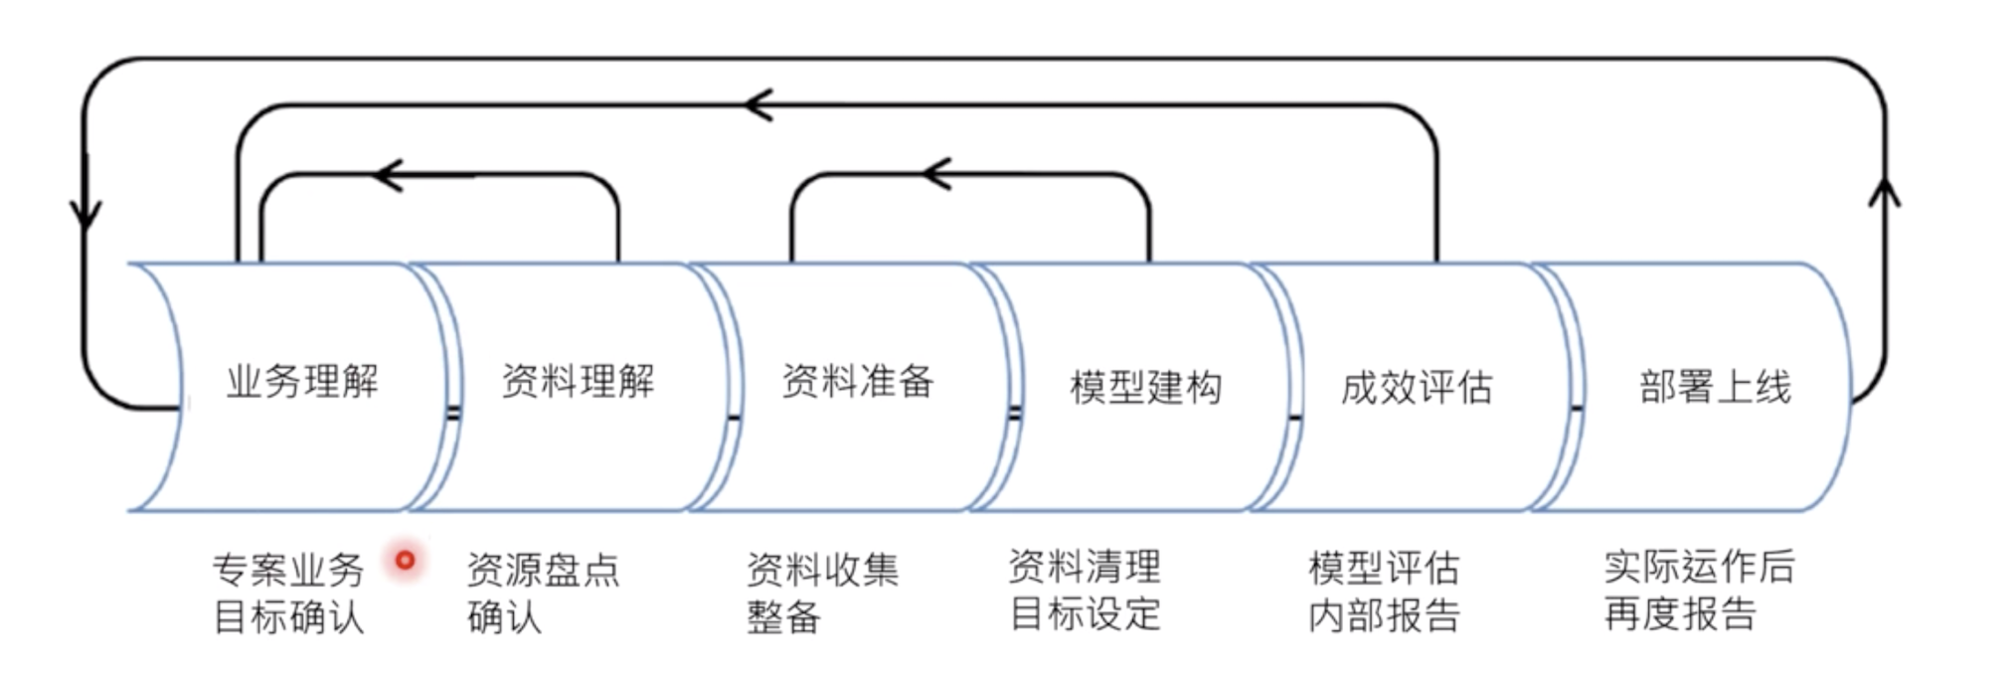
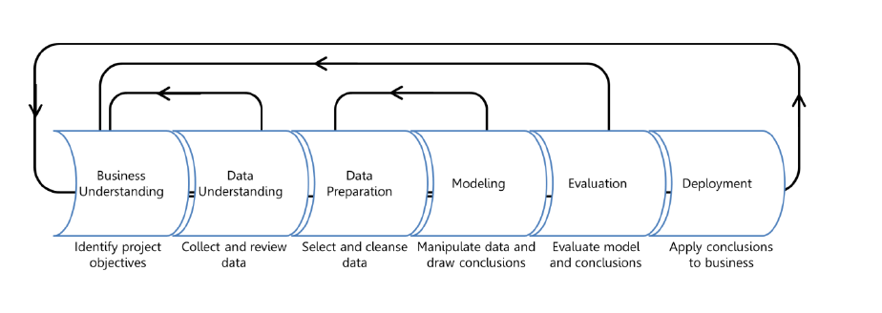
数据科学运作过程 Data Science Process
首要挑战，从巨量资料中挖掘有意义的线索
Extracting value from large amounts of data and making human sense of it is the primary challenge of data science.
Domain Expertise
Data
Science
Code/Computing Expertise
Math/Statistics
from Introduction to Data Science on Microsoft Learn: https://docs.microsoft.com/learn/modules/intro-to-data-science-in-azure/2-data-science-process
Helpful beginners' series: https://docs.microsoft.com/en-us/azure/machine-learning/studio/data-science-for-beginners-the-5-questions-data-science-answers
Notes:
So before we start experimenting with code and data science techniques, it’s important to begin with a conceptual understanding of how data science often works. We begin by…
Understand the business problem
In any problem-solving method the problem must first be identified. This can either be in the form of a question or a statement. There is always a general business understanding that will motivate the data science process in each situation.
In our example, your company understands they could be selling more brooms if they knew how many they could expect to sell each month, and stock their shelves accordingly.
Understand and prepare the data
Data understanding comes from the process of acquiring and exploring available data. This step involves obtaining and preparing the data to be used in model training. To train models, it's important to understand the data. Data scientists start by performing exploratory data analysis (EDA) to better understand the data they're working with, and identify which data elements drive the outcome they want to predict. With this understanding, can cleanse the data and extract the features required for modeling.
Your company gives their data to the data science team. The data engineer cleans and preps the data so that it's ready for the modeling process. EDA helps you learn about the relationship among data elements, which helps determine which data (or features) you will need to train the model. For example, it might help to know what people most frequently buy with brooms.
Model the data
The modeling step is a cycle of steps that occur to improve results. Modeling can consist of several techniques, but typically one cycle iteration is not enough to produce good results, so the cycle is repeated until the desired results are achieved.
You use the available data and move into modeling and feature engineering. For this type of question where there are many different numerical variables, you try a time series model and evaluate its performance.
Deployment
This step is usually left to the developers. It consists of integrating the solution into the business to solve the original problem. For your company, deployment would mean using the prediction of broom sales to properly stock the shelves.
Summary
Data science is a data-driven process that starts with a question. Data acquisition and understanding then drives the modeling. The steps a data scientist usually focuses on are data understanding and modeling, which is where the results are produced. After that, the developer implements the results to test the performance.

Slide 8

模型
Model
感官输入
Sensory Input
行为
Behavior
Notes:
I’m a dad. Who else here is a parent? Mine are teenagers now, and it’s trite to say it, but it seems like they were just babies yesterday. And it seems like just yesterday that I was a lot younger too, a hopelessly naïve new parent who thought that the job of a parent is to teach his children things. To explain the world to them. And actually I remember being stressed out because I didn’t know everything. How was I going to explain the world to my baby if I didn’t know everything? I literally started reading a lot more nonfiction.

Slide 9

模型
Model
数据
Data
答复
Answers
Notes:
The first time I showed this to Micheleen I asked her how she liked me drawing and she said, “it scared me.”

Slide 10
运算法则
Algorithms
病变？
Diseased?
Notes:
Start with a specific question: “Is this retinal scan of a diseased eye?”
Build the puzzle by necessity. Don’t mention something new (features) until you need it.
Built the puzzle
Talk about how you spend your time (calling out data wrangling as something that developers already do – “metadata scientist”)
Talk about math, how much you need, where you need it
Also a chance to talk about hidden bias in data, e.g. skew towards men in software. So an ML “should I hire this person” would weight men heavily. The data is not bad, it’s just reflecting a situation that is itself the result of bias. The way to subtract it is to extract it explicitly.
But this is also an opportunity! We can’t subtract bias from people’s brains, but we can subtract it from models. So that “hiring engine” may in the end be a force for social justice.

Slide 11
在这里工作，你不必懂数学...但懂的話会有帮助！
You don’t have to know math to work here… but it helps!

Slide 12
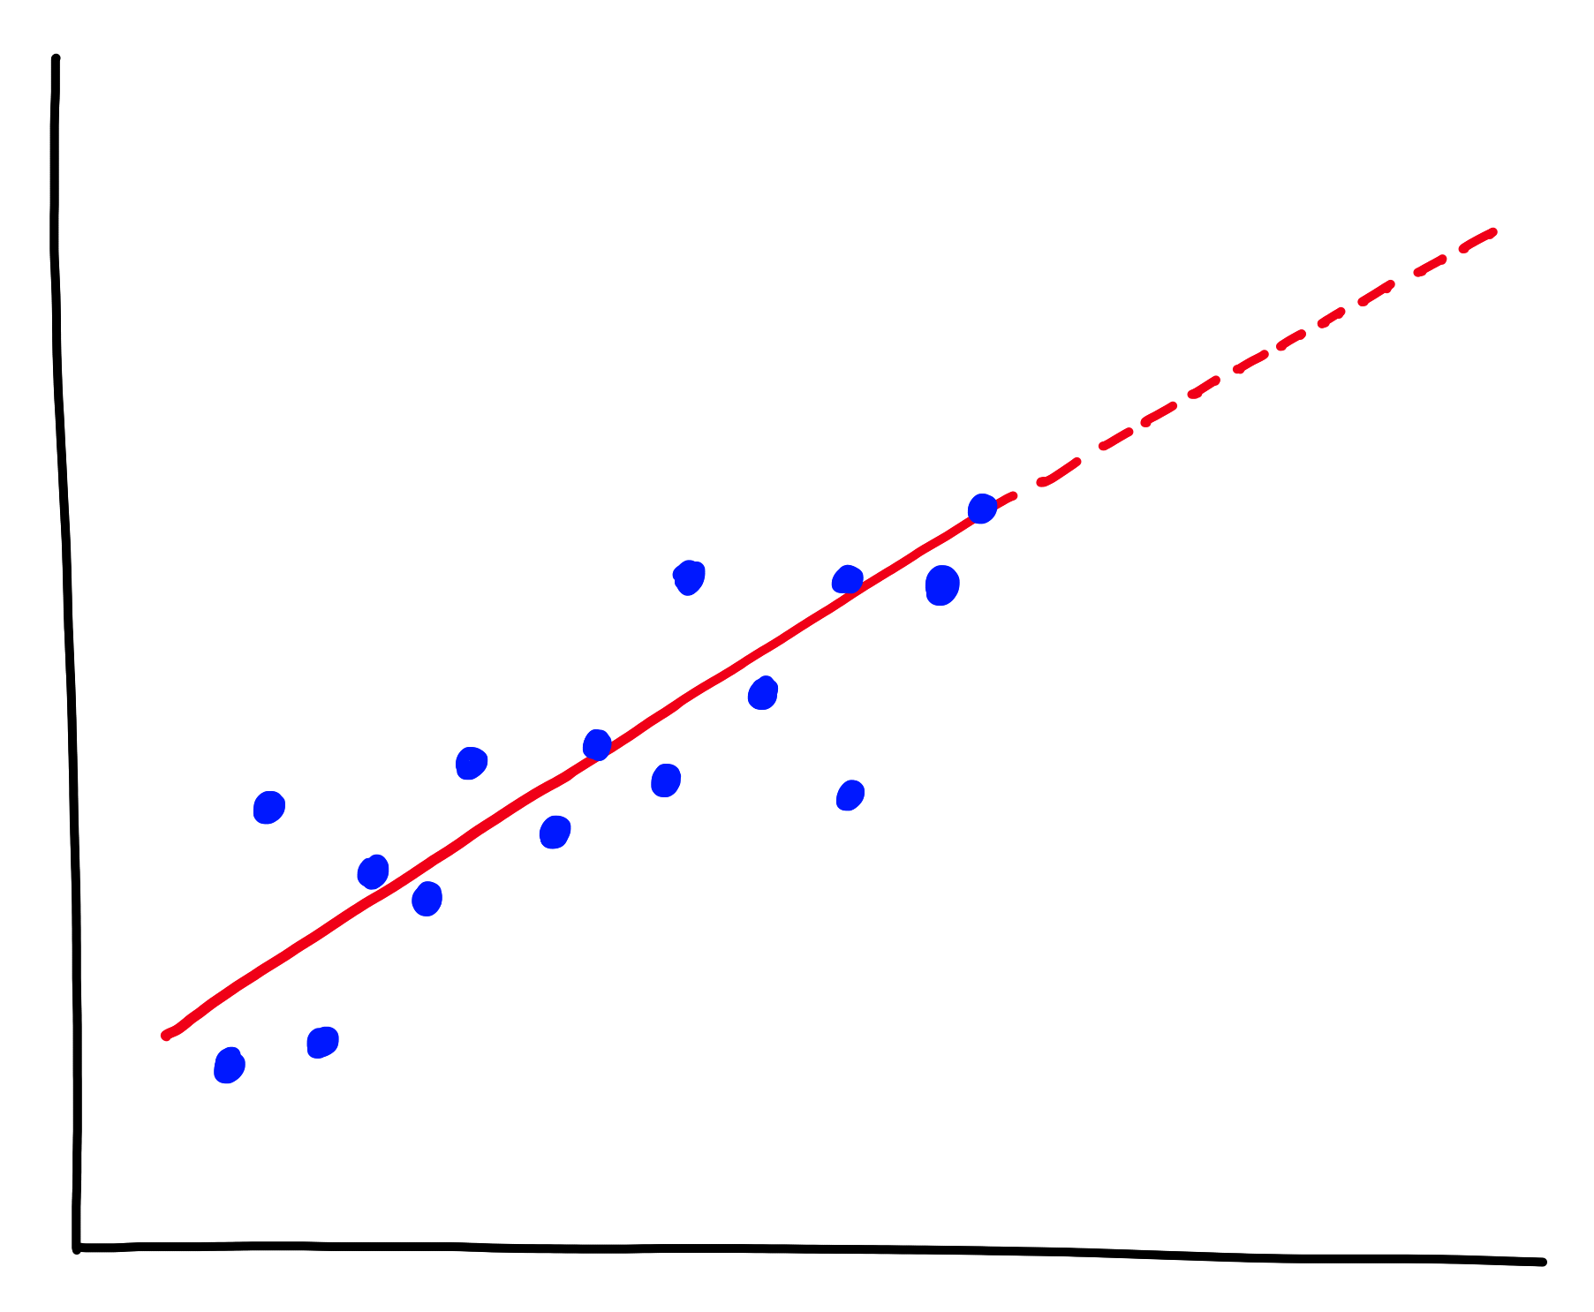
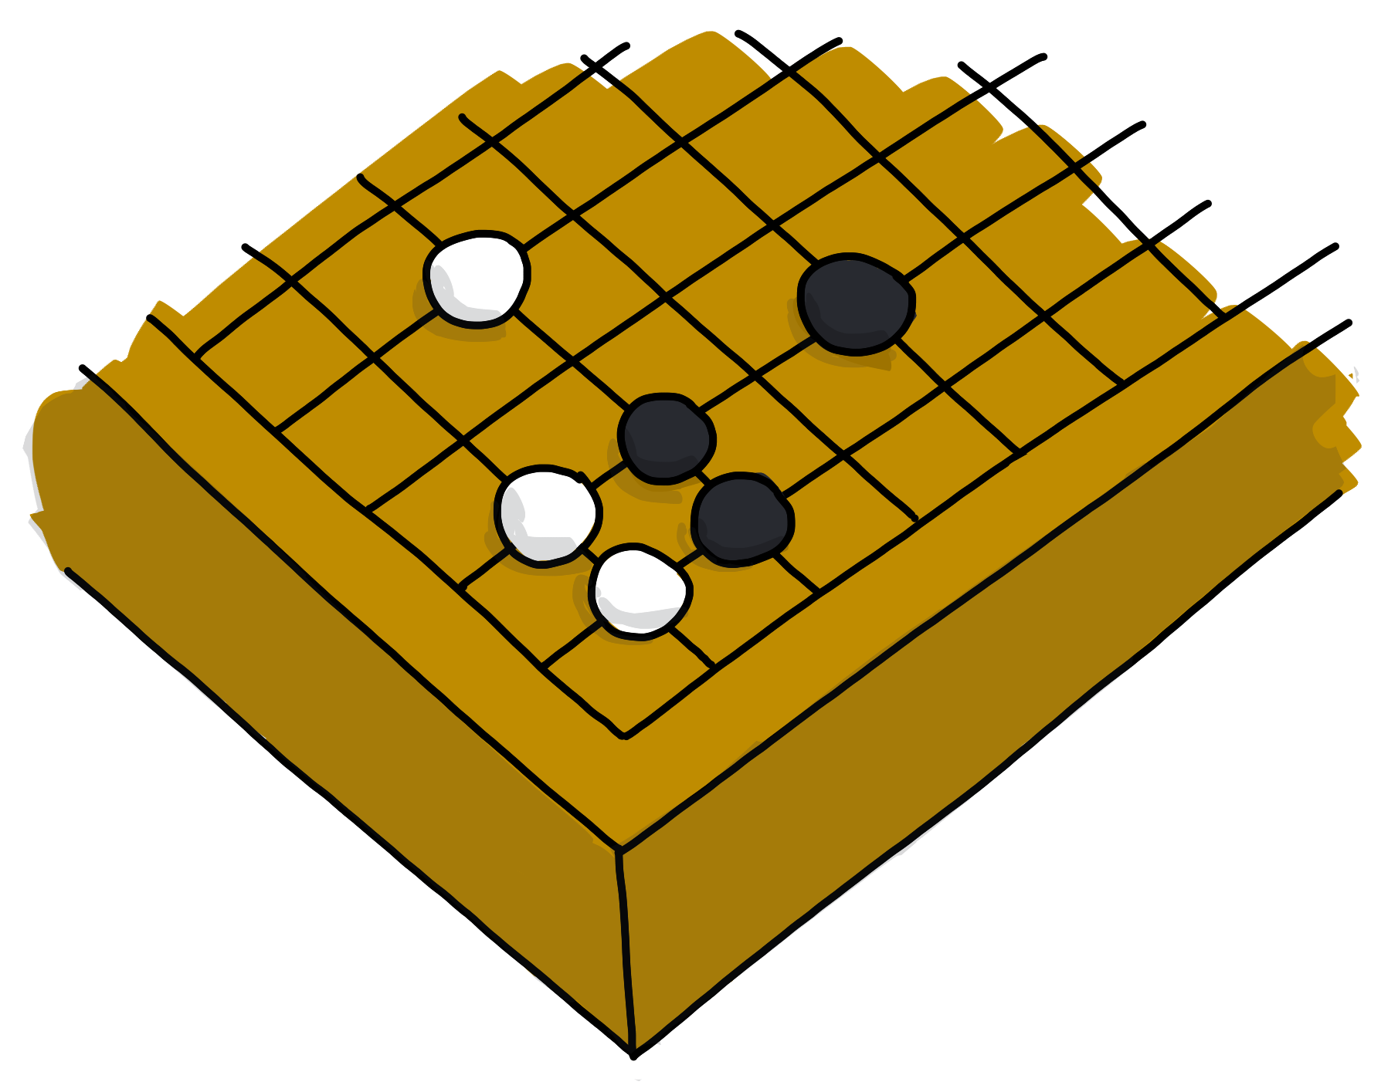
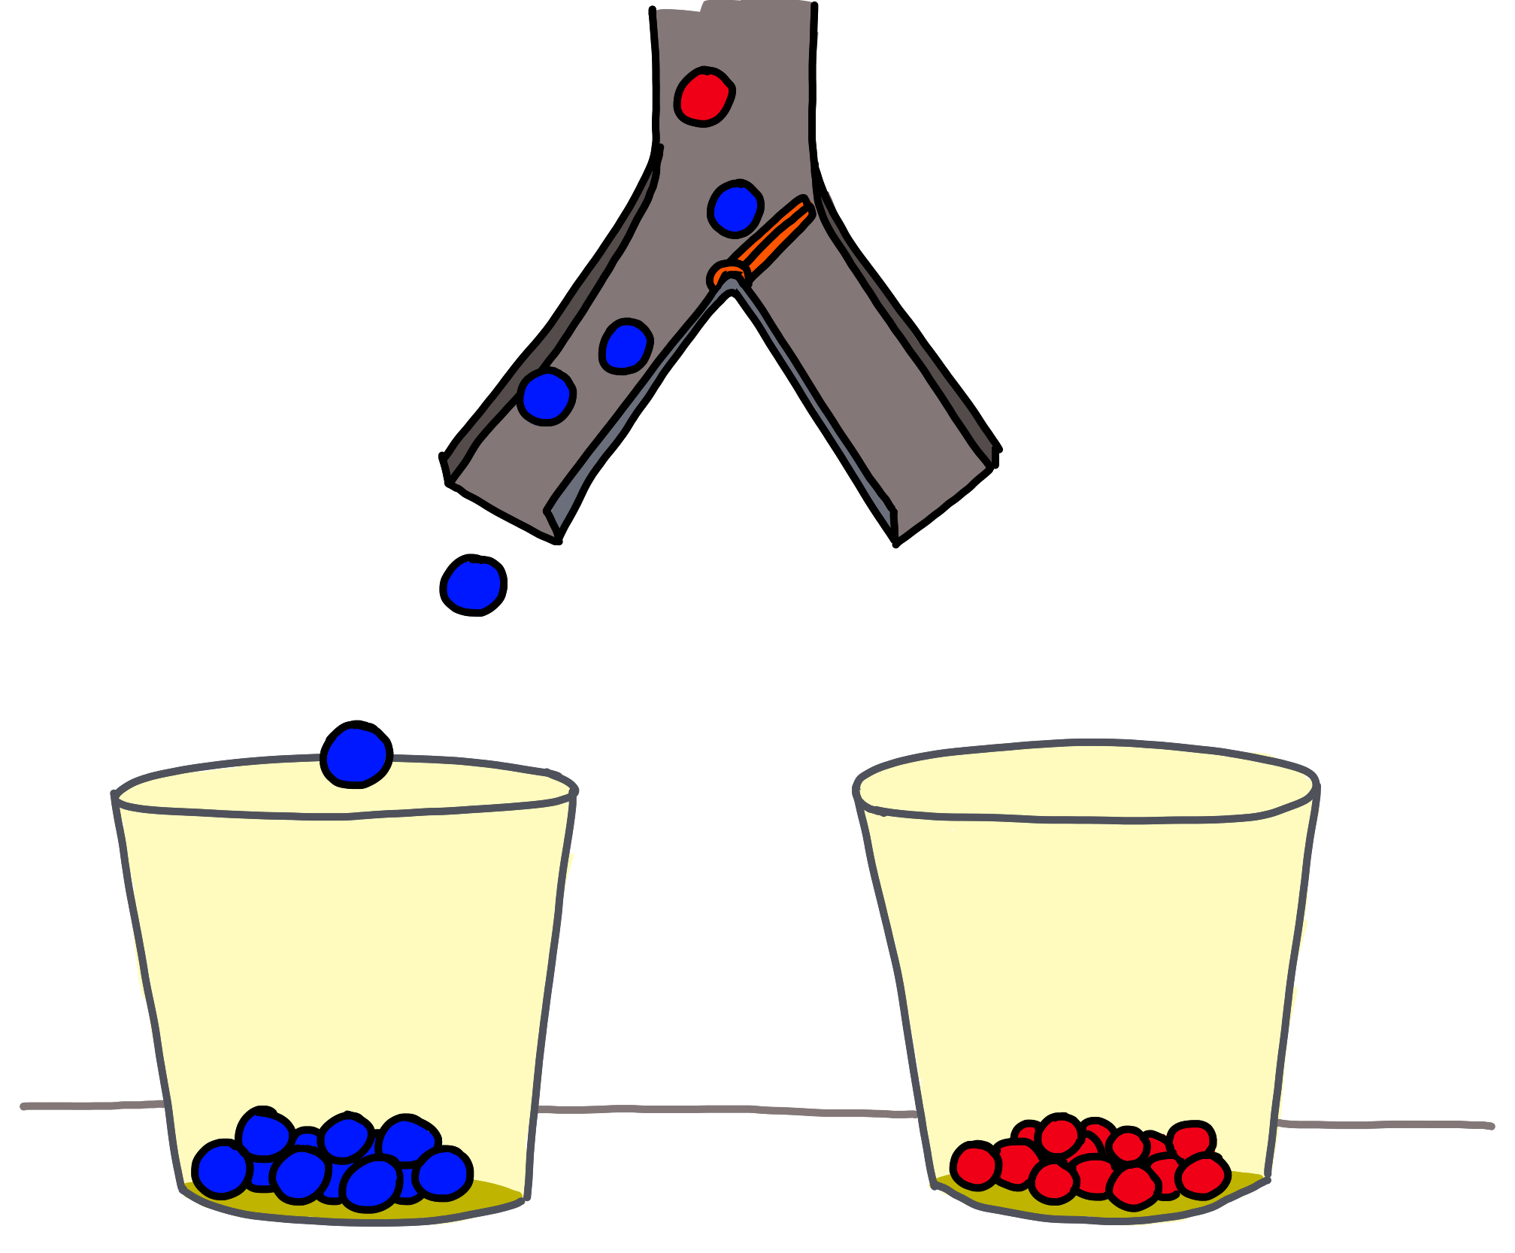
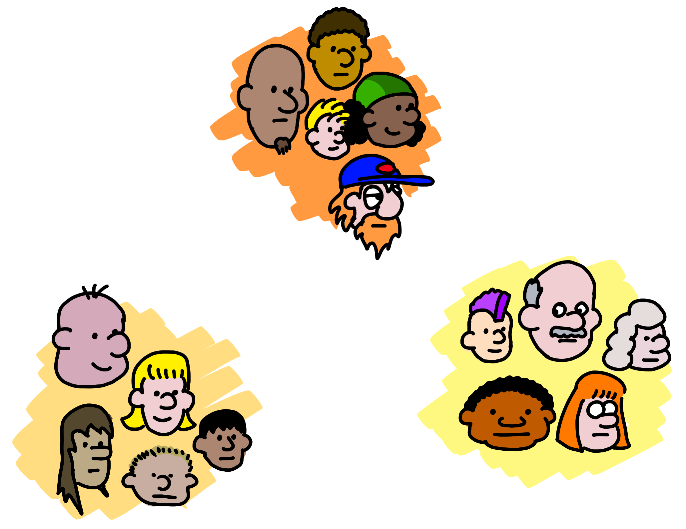
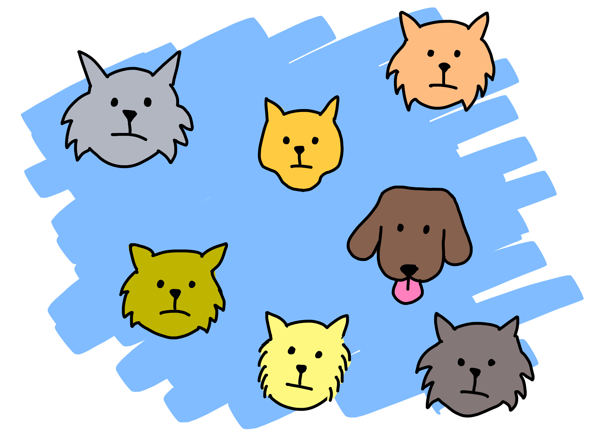
预测有多少
Predict how much/many
（回归）
(Regression)
接下来呢？
What next?
（强化学习）
(Reinforcement Learning)
哪个类别？ Which category?
（分类）(Classification)
怪异之處？ Is it weird?
（异常）
(Anomaly)
数据结构 Data structure
（聚类，推荐）
(Clustering,
Recommender)
5 questions courtesy Brandon Rohrer
Notes:
The five questions you can answer with traditional ML
Regression: Predict a real value for new data given trends in tagged example. How much/how many? e.g. Sea level rise: we are currently using data on sea level changes over the past century and the accelerating upward trend to estimate the amount of sea level rise in the coming century.
Anomaly: Identify when something unexpected happens. – Is this weird? E.g. Pacemaker hacking: research is being done to detect malware in a pacemaker in order to prevent data hijacking or malware-related malfunctioning by using an anomaly detector to pick up changes in data transmission timing to a cardiac log or even power consumption and electromagnetic radiation changes.
Reinforcement Learning: Take some appropriate action or next step E.g. Roomba or Roomba-competitor: a Roomba decides whether to return to the base or vacuum the living room again – there’s some sort of reward/penalty involved here.
Classification: Assign a category to each item or data point E.g. Exploring the night sky for planets: light curves (stellar brightness over time) of a unexamined stars with Kepler data are being classified as either having transiting planets or not using a pre-trained model on stars with and without transiting planets.
Clustering/Recommenders: Get to the structure or layout of data. Are there clearly separable groups? E.g. Hepatocellular carcinoma metastasis: researchers are looking at the differential profiles of proteins being expressed to find those that are upregulated during the cell invasion process in order to find new cancer treatment targets.
Also questions you can’t ask. Que

Slide 13
让我们从克隆工作坊笔记本开始 Let’s begin by cloning our workshop Notebook
https://notebooks.azure.com/geektrainer/projects/ml-2
如果您还没有 Microsoft 帐户， 请于此处申请 ：
If you don’t already have a Microsoft Account, start here:
account.microsoft.com

Slide 14
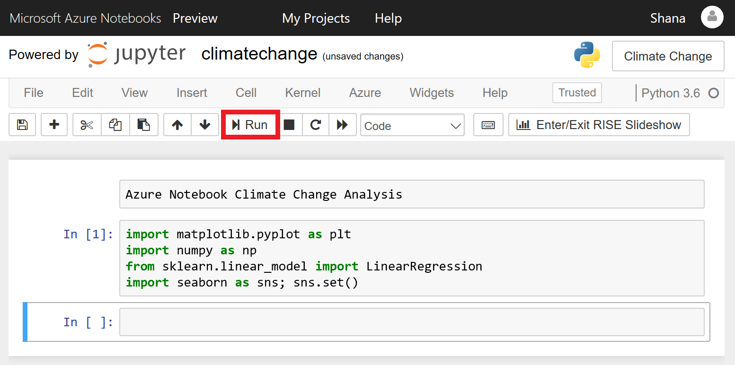
如何在 Azure 笔记本中导航 How to navigate Azure Notebooks
https://docs.microsoft.com/en-us/learn/modules/analyze-climate-data-with-azure-notebooks/1-create-an-azure-notebook
Notes:
Azure Notebooks is a cloud-based platform for building and running Jupyter notebooks. Jupyter is an environment based on IPython that facilitates interactive programming and data analysis using a variety of programming languages, including Python. Jupyter notebooks enjoy widespread use in research and academia for mathematical modeling, machine learning, statistical analysis, and for teaching and learning how to code.
Azure Notebooks provide Jupyter as a service for free. It's a convenient way to build notebooks and share them with others without having to install and manage a Jupyter server. And it's web-based, making it an ideal solution for collaborating online. In this lab, you will create an Azure Notebook and use three popular Python libraries — scikit-learn, NumPy, and Seaborn — to analyze your data. Then you will share the notebook so others can experiment with it, too.

Slide 15
K-means 聚类（ K均值聚类 ） K-means clustering
Notes:
Supervised machine learning (ML), in which we provide labeled training data for the algorithm. k-means clustering is the first unsupervised ML algorithm that we have dealt with: we provide the algorithm with a set of $n$ data points and tell the algorithm that we want that data partitioned into $k$ clusters that provide the best separation between clusters.

Slide 16
问题 The question
哪些食物的营养成分相似？
What foods have similar amounts of nutrients?

Slide 17
问题型态 The question type
聚 类
Clustering

Slide 18
K-means 聚类 K-means clustering
算法 The algorithm
Notes:
Supervised machine learning (ML), in which we provide labeled training data for the algorithm. k-means clustering is the first unsupervised ML algorithm that we have dealt with: we provide the algorithm with a set of $n$ data points and tell the algorithm that we want that data partitioned into $k$ clusters that provide the best separation between clusters.

Slide 19
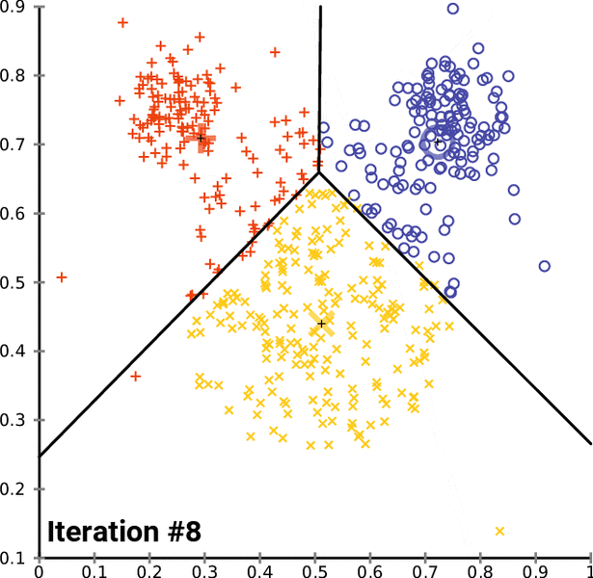
K-means 理论 K-means theory
无监督式 ML 分类
无需正确分类的示例 用戶要做的就是提供聚类数去拟合
算法用迭代的方式拟合这些簇，直到达到最佳拟合
Unsupervised ML classification
Needs no examples of correct classifications
All user does is supply number of clusters (or groups) to fit
Algorithm iteratively fits those clusters until it arrives at best fit
Notes:
The k-means algorithm is an example of unsupervised ML: all we do is give it the number of clusters to superimpose over a dataset and the algorithm goes to work knowing nothing about the data (such as examples of accurate classifications).
The k-means algorithm works by randomly assigning $k$ centroids (or geometric centers of subsets of the dataset as measured through Euclidean distance) to the data and then iteratively moving those centroids around the feature space until it converges on an arrangement of the centroids that minimizes the variance within the clusters.
Because k-means uses Euclidean distance, it is also a very fast algorithm for classifying new data points.

Slide 20
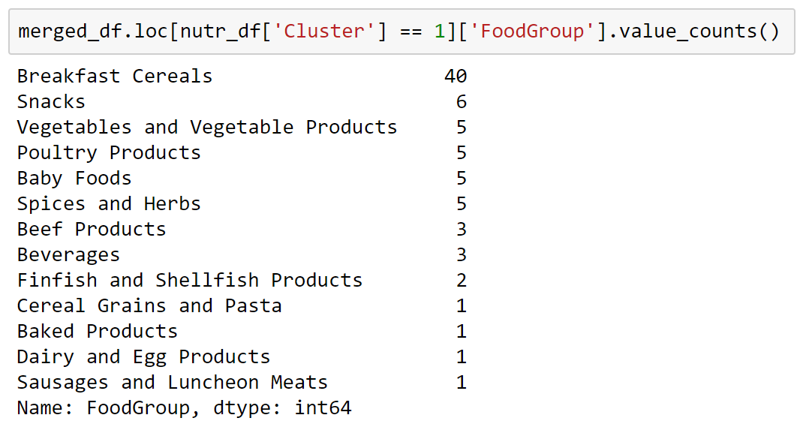
解读 k-means 聚类 Interpreting k-means clusters
数据点间的相似度是在特征空间中的最短距离 簇代表一群相似的对象
Data points similar to each other are the shortest distance apart in features space
Clusters represent groupings of similar items
Notes:
What sorts of foods populate the different clusters? We will examine that question in greater depth in the section, but we can get some sense of our clusters just by looking at the food groups in one of them.
Some of the entries in this cluster make sense, whereas others look kind of like the contents of a grab bag. Part of the reason for this is that the k-means algorithm has to draw rather arbitrary boundaries between clusters; there will be a lot of entries in all clusters that are right on the edge and could reasonably belong to two or more clusters.

Slide 21
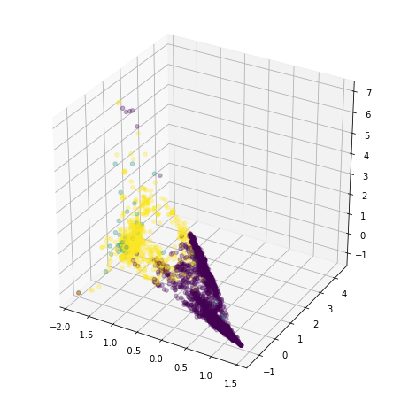
可视化 k-means 聚类 Visualizing k-means clusters
簇之间的边界在较低维度将难以区别。 降维投影会使一些簇彼此混淆。
Boundaries between clusters are not distinct at lower dimensions.
Some groups appear smeared through each other because of projection downward.
Notes:
Similar to the situation with PCA, we can create visualizations of our clusters, but visualization is crude at best when it has been projected downward through so many dimensions. That said, even when trying to project from 43 dimensions down to 3 dimensions, noticeable patterns persist.
Notice that there’s no hard boundary visible between the purple and yellow clusters. The boundary is there, but because it's a higher-dimensional hyperplane, it gets smeared across three-dimensional space.
Note also that points from the light blue cluster are scattered across the plot. This is also an artifact of the clusters’ projection down from 43 dimensions to 3.

Slide 22
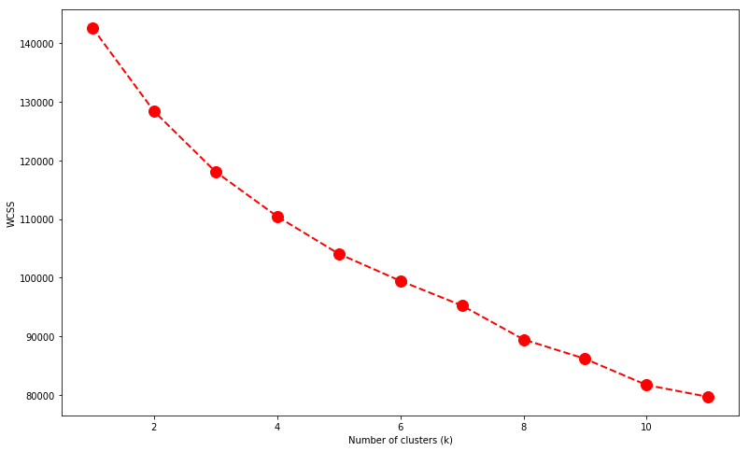
解读 k-means簇 Interpreting k-means clusters
Elbow graph和主成份分析中的陡坡图相似。 找寻簇中变异性开始不再明显下降的点。
Elbow graph similar to scree plot in PCA
Looks for point at which variability in clusters begins to diminish
Notes:
In practice, determining the correct number of clusters can require a lot of domain knowledge and data interpretation. However, we can use the elbow method as a rough heuristic for determining the number of clusters to use, even absent any domain knowledge.
With the elbow method, we plot the within-cluster sum of squares (WCSS, a measure of the variability of the observations within each cluster) against different values of $k$. As with the scree graph we used with PCA, we’re looking for the value of $k$ near where WCSS begins to flatten out and form an elbow-shaped curve.

Slide 23
朴素贝叶斯 Naïve Bayes
Notes:
In contrast to k-means clustering, Naive Bayes is a supervised machine-learning (ML) algorithm. It provides good speed and good accuracy, and it is often used in aspects of natural-language processing such as text classification or, in our case in this section, spam detection.
Spam emails are more than just a nuisance. As recently as 2008, spam constituted an apocalyptic 97.8 percent of all email traffic, according to a 2009 Microsoft security report. That tide has thankfully turned, and, as of May 2019, spam makes up only about 85 percent of email traffic—thanks in no small part to naive Bayes spam filters.
Naive Bayes is a convenient algorithm for spam detection because it does not require encoding complex rules. All it needs is training examples, of which there are plenty when it comes to email spam. Naive Bayes does all this through the use of conditional probability.

Slide 24
问题 The question
此邮件是垃圾邮件吗？
Is this message spam?

Slide 25
问题型态 The question type
分类
Classification

Slide 26
K-means聚类 K-means clustering
算法 The algorithm
Notes:
Supervised machine learning (ML), in which we provide labeled training data for the algorithm. k-means clustering is the first unsupervised ML algorithm that we have dealt with: we provide the algorithm with a set of $n$ data points and tell the algorithm that we want that data partitioned into $k$ clusters that provide the best separation between clusters.

Slide 27
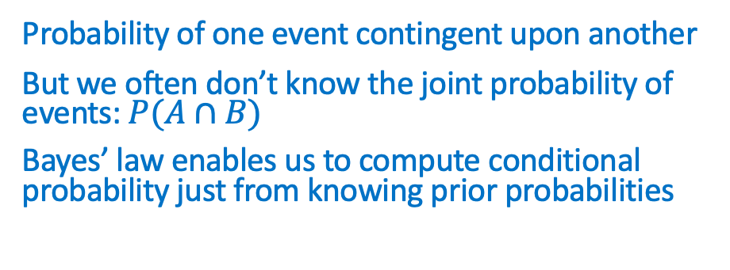
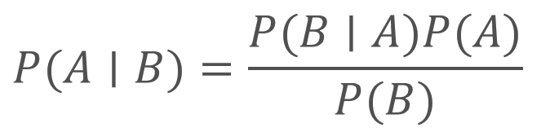
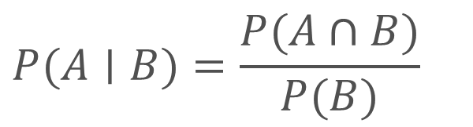
条件概率与贝叶斯定律 Conditional probability and Bayes’ law
一个事件的概率取决于另一个事件
但是我们常常不知道事件的联合概率：P（A∩B） 贝叶斯定律使我们能够仅根据先验概率来计算条件概率
$$P(A∣B)=\frac{P(A∩B)}{P(B)}$$
Probability of one event contingent upon another
But we often don’t know the joint probability of events: $P(A∩B)$
Bayes’ law enables us to compute conditional probability just from knowing prior probabilities
$$P(A∣B)=\frac{P(B∣A)P(A)}{P(B)}$$
Notes:
Ordinary probability deals with the likelihood of isolated events occurring. Conditional probability concerns itself with the contingencies of interconnected events: what is the probability of event $A$ happening if event $B$ occurs. Mathematicians denote this as $P(A∣B)$, or “the probability of $A$ given $B$.”
However, to compute conditional probabilities, we need know the joint probability $P(A∩B)$, which we often don't. Instead, we often need to know something about $A$, but all we can directly observe is $B$. An example of this is when we want to infer whether an email is spam only by knowing the words it contains. For this, we need Bayes' law.
Bayes’ law takes its name from the eighteenth-century English statistician and philosopher Thomas Bayes, who described the probability of an event based solely on prior knowledge of conditions that might be related to that event. In words, Bayes’ law says that if I know the prior probabilities $P(A)$ and $P(B)$, in addition to the likelihood (even just an assumed likelihood) $P(B∣A)$, I can compute the posterior probability $P(A∣B)$. Let's apply this to spam.

Slide 28
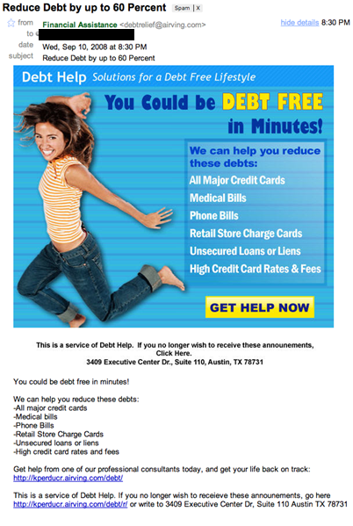
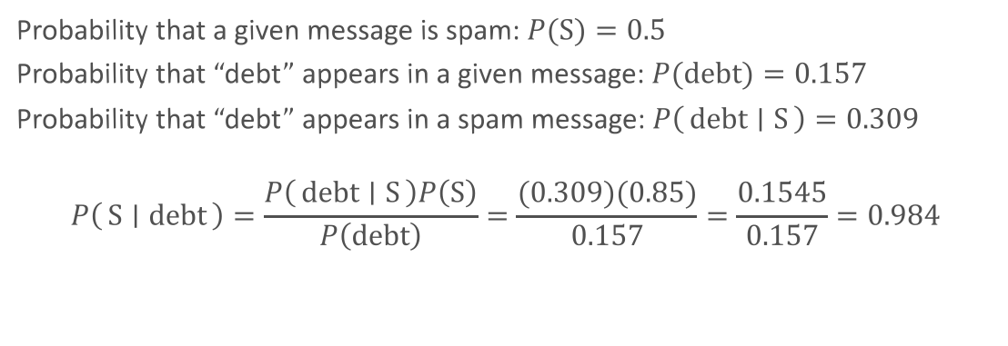
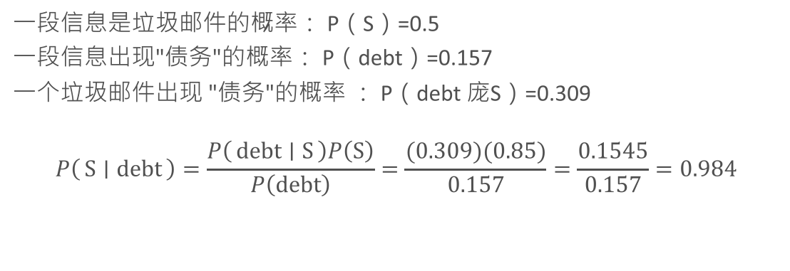
基于贝叶斯定律的垃圾邮件过滤机制 Bayes’ law for spam filtering
一段信息是垃圾邮件的概率： P（S）=0.5 一段信息出现"债务"的概率： P（debt）=0.157 一个垃圾邮件出现 "债务"的概率 ： P（debt 庞S）=0.309
$$P\left(S ∣ debt\right)=\frac{P\left(debt ∣ S\right)P\left(S\right)}{P\left(debt\right)}=\frac{(0.309)(0.85)}{0.157}=\frac{0.1545}{0.157}=0.984$$
Probability that a given message is spam: $P(S)=0.5$
Probability that “debt” appears in a given message: $P(debt)=0.157$
Probability that “debt” appears in a spam message: $P\left(debt ∣ S\right)=0.309$
$$P\left(S ∣ debt\right)=\frac{P\left(debt ∣ S\right)P\left(S\right)}{P\left(debt\right)}=\frac{(0.309)(0.85)}{0.157}=\frac{0.1545}{0.157}=0.984$$
Notes:
To use Bayesian probability on spam email messages like this one, consider it (and all other emails, whether spam or ham) to be bags of words. We don’t care about word order or even word meaning. We just want to count the frequency of certain words in spam messages versus the frequency of those same words in valid email messages.
Let’s say that, after having counted the words in hundreds of emails that we have received, we determine the probability of the word “debt” appearing in any kind of email message (spam or ham) to be 0.157, with the probability of “debt” appearing in spam messages being 0.309. Furthermore, let’s say we assume that there’s a 50-percent chance that any given email message we receive is spam (for this example, we don't know either way what type of email it might be, so it’s basically a coin flip).
By the calculations on the slide, if an email contains the word “debt,” we predict that it is 98.4 percent likely to be spam.

Slide 29
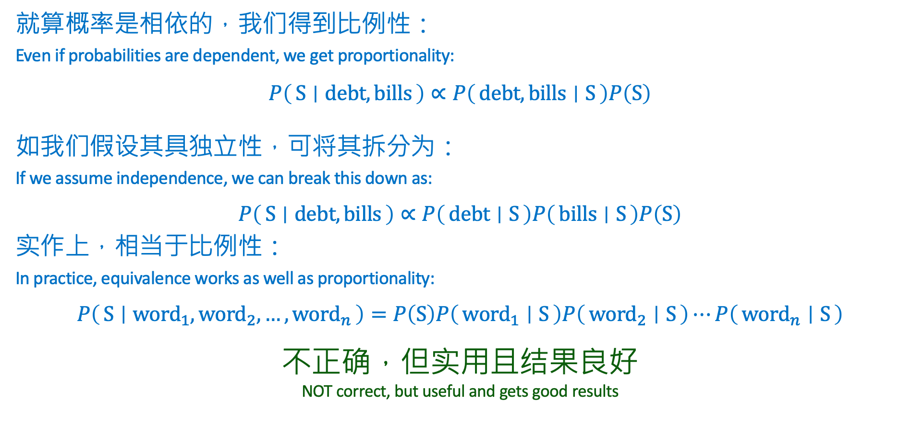
朴素的假设 The naïve assumption
就算概率是相依的，我们得到比例性：
Even if probabilities are dependent, we get proportionality:
$$P\left(S ∣ debt, bills\right)∝P\left(debt, bills ∣ S\right)P\left(S\right)$$
如我们假设其具独立性，可将其拆分为：
If we assume independence, we can break this down as:
$$P\left(S ∣ debt, bills\right)∝P\left(debt ∣ S\right)P\left(bills ∣ S\right)P\left(S\right)$$
实作上，相当于比例性：
In practice, equivalence works as well as proportionality:
$$P\left(S ∣ {word}_{1}, {word}_{2},…,{word}_{n}\right)=P\left(S\right)P\left({word}_{1} ∣ S\right)P\left({word}_{2} ∣ S\right)⋯P\left({word}_{n} ∣ S\right)$$
不正确，但实用且结果良好 NOT correct, but useful and gets good results
Notes:
Our above calculation is great for looking at individual words, but emails contain several words that can give us clues to an email’s relative likelihood of being spam or ham. For example, say we wanted to determine whether an email is spam given that it contains the words “debt” and “bills.” We can begin by reasoning that the probability that an email containing “debt” and “bills” is spam is, if not equal, at least proportional to the probability of “debt” and “bills” appearing in known spam messages times the probability of any given message being spam: $P\left(S ∣ debt, bills\right)∝P\left(debt, bills ∣ S\right)P\left(S\right)$
Now, if we assume that the occurrence of the words “debt” and “bills” are independent events, we can extend this proportionality: $P\left(S ∣ debt, bills\right)∝P\left(debt ∣ S\right)P\left(bills ∣ S\right)P\left(S\right)$
We should state here that this assumption of independence is generally not true. Just look at the example spam message above. The probability that “bills” will appear in a spam message containing “debt” is probably quite high. However, assuming that the probabilities of words occurring in our email messages are independent is useful and works surprising well. This assumption of independence is the naive part of the Bayesian probabilities that we will use in this section. Expressed mathematically, the working assumption that will underpin the ML in this section is that for any collection of $n$ words: $P\left(S ∣ {word}_{1}, {word}_{2},…,{word}_{n}\right)=P\left(S\right)P\left({word}_{1} ∣ S\right)P\left({word}_{2} ∣ S\right)⋯P\left({word}_{n} ∣ S\right)$
We cannot emphasize enough that this chain rule expressed in the equation above—that the probability of a message being spam based on the words in it is equal to the product of the likelihoods of those individual words appearing in messages known to be spam—is not true. But it gets good results and, in the world of data science, fast and good enough always trump mathematical fidelity.

Slide 30
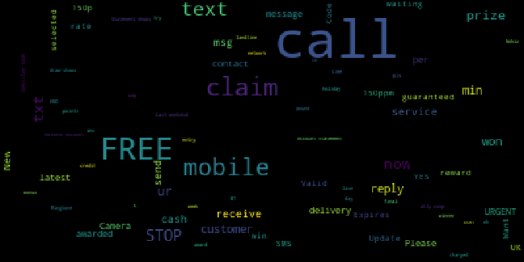
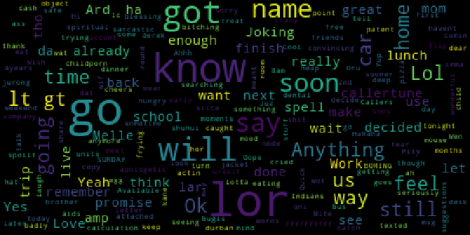
探索数据：词云 Exploring the data: word clouds
垃圾 邮件
Spam
正常 邮件
Ham
来自垃圾邮件研究并且标有「spam（垃圾邮件）」或「ham（正常邮件）」的5574则信息数据集。
Dataset of 5,574 messages collected for SMS spam research and tagged as “spam” or “ham.”
Notes:
In this section, we will use the SMS Spam Collection dataset. It contains 5,574 messages collected for SMS spam research and tagged as “spam” or “ham.” The dataset files contain one message per line, with each line being composed of the tag and the raw text of the SMS message.
Because our data is largely not numeric, you might have noticed that some of our go-to data exploration tools (such as bar charts and the describe() method) have been of limited use in exploring this data. Instead, word clouds can be a powerful way of getting a quick glance at what's represented in text data as a whole.
Looking at the two word clouds, it’s immediately apparent that the frequency of the most common words is different between our spam and our ham messages, which will form the primary basis of our spam detection.

Slide 31
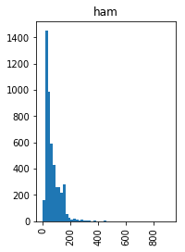
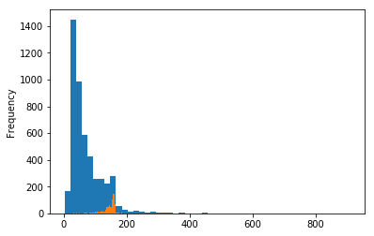
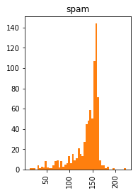
浏览数据：信息长度 Exploring the data: message length
一般来说，垃圾邮件比正常邮件要长得多。
On average, spam messages are much longer than ham messages.
Notes:
Just because the data does not naturally lend itself to numerical analysis “out-of-the-box” does not mean that we can't do so. We can also analyze the average length of spam and ham messages to see whether there are differences. And, sure enough, spam messages are much longer on average than ham messages.

Slide 32
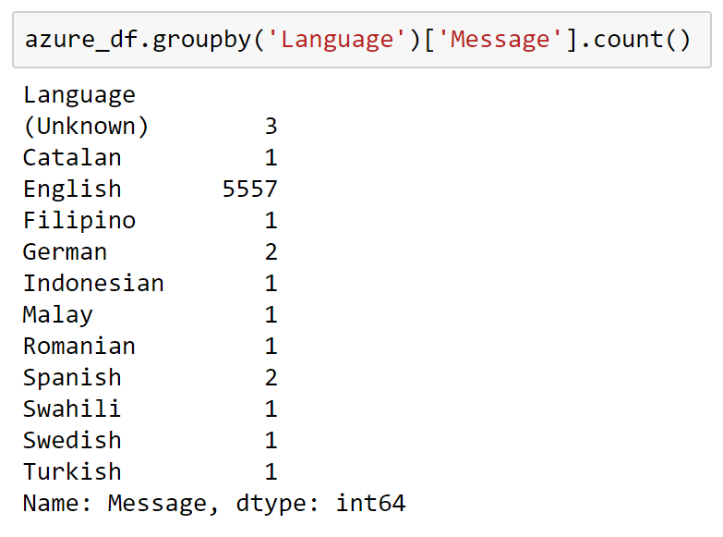
探索数据：语言 Exploring the data: languages
我们可以使用Azure Cognitive Services来识别编写信息所用的语言。
We can use Azure Cognitive Services to identify the languages in which messages are written.
部分非英语邮件不应影响垃圾邮件检测。
The sprinkling of non-English messages should not impact spam detection.
Notes:
The advantage of using cloud-based services is that they provide cutting-edge models that you can access without having to train the models. This can help accelerate both your exploration and your use of ML.
Azure provides Cognitive Services APIs that can be consumed using Python to conduct image recognition, speech recognition, and text recognition, just to name a few. For the purposes of this subsection, we're going to look at using the Azure Text Analytics API.
The overwhelming majority of the messages are in English, though we have several additional languages in our dataset. Let's look at the actual numbers.

Slide 33
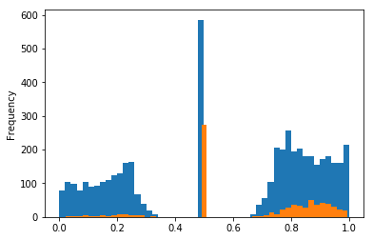
探索数据：情感 Exploring the data: sentiment
Azure Cognitive Services 还可以识别信息的情感。
多數垃圾邮件是中性的。
垃圾邮件往往正向多于負向。.
Azure Cognitive Services can also identify the sentiment of messages.
A disproportionate number of spam messages are neutral.
Spam messages also tend to be more positive than negative.
Notes:
It’s perhaps not too surprising that the sentiments represented in the dataset should be bifurcated: SMS is a medium that captures extremes better than nuanced middle ground. That said, the number of dead-center messages is interesting. The proportion of spam messages right in the middle is also interesting.

Slide 34
问题 The question
人均国内生产总值是否对女性预期寿命产生影响？
Does per-capita GDP have an impact on female life expectancy?

Slide 35
问题型态 The question type
回归
Regression

Slide 36
线性和多项式回归 Linear and polynomial regression
算法 The algorithm
Notes:
Supervised machine learning (ML), in which we provide labeled training data for the algorithm. k-means clustering is the first unsupervised ML algorithm that we have dealt with: we provide the algorithm with a set of $n$ data points and tell the algorithm that we want that data partitioned into $k$ clusters that provide the best separation between clusters.

Slide 37
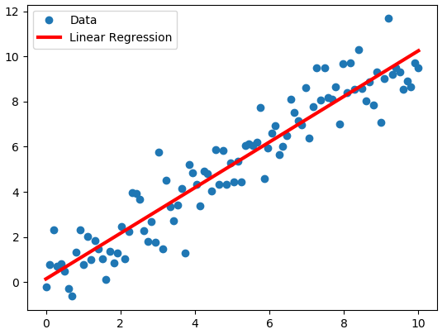
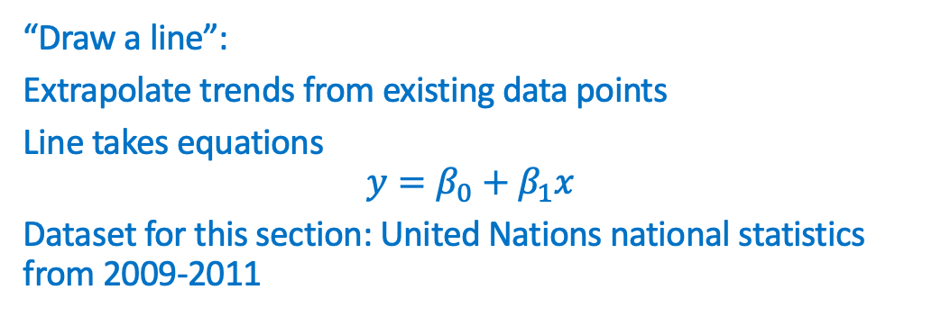
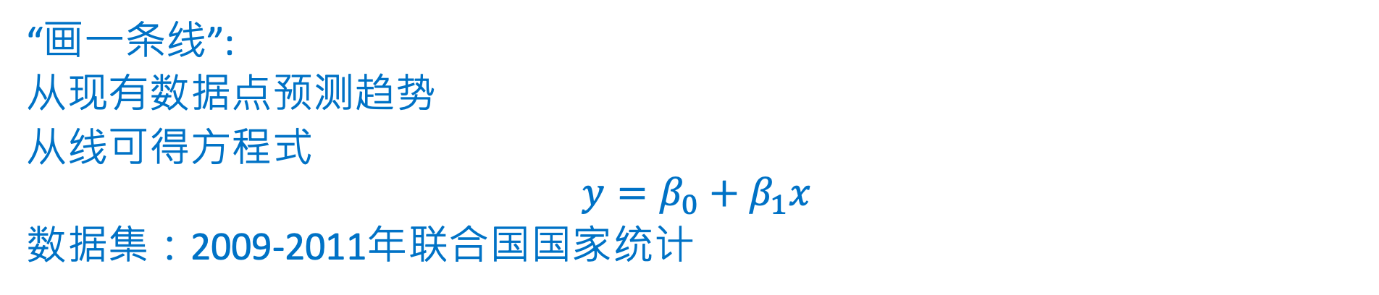
回归综览 Overview of regression
“画一条线”:
从现有数据点预测趋势
从线可得方程式
$$y=β_{0}+β_{1}x$$
数据集：2009-2011年联合国国家统计
“Draw a line”:
Extrapolate trends from existing data points
Line takes equations
$$y=β_{0}+β_{1}x$$
Dataset for this section: United Nations national statistics from 2009-2011
Notes:
The essence of linear regression is arguably the simplest form of ML: drawing a line through points. You might have done a simple form of this in your high school physics class: plot the results of a series of experiments on graph paper, and then draw a line through as many points as possible (and include as many points below the line as above the line where the points don't fall on the line). That is a basic form of linear regression. We will build on that conceptual foundation to address more complex situations, such as having points in more than two dimensions or even points whose relationship seems non-linear.
Formally, linear regression is used to predict a quantitative response (the values on a Y axis) that is dependent on one or more predictors (values on one or more axes that are orthogonal to $Y$, commonly just thought of collectively as $X$). The working assumption is that the relationship between the predictors and the response is more or less linear. The goal of linear regression is to fit a straight line in the best possible way to minimize the deviation between our observed responses in the dataset and the responses predicted by our line, the linear approximation.
How do we tell whether we have the best fit possible for our line? The most common means of assessing the error between the fit of our line—our model—and the data is called the least squares method. This method consists of minimizing the number you get when you square the differences between your predicted values (the line) and the actual values (the data) and add up all of those squared differences for your entire dataset.
In this section and the next (3.2), we will use national statistics gathered by the United Nations (UN) from 2009–2011 (accessed from the United Nations Statistics Division's Social indicators page on April 23, 2012). The data includes national health and welfare statistics for 199 countries and territories; these locations are mostly UN members, but the list also includes other areas that are not independent countries (such as Hong Kong).

Slide 38
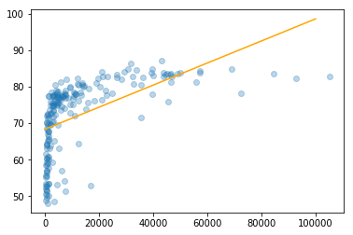
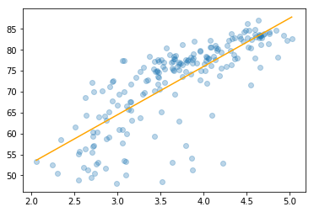
简单线性回归 Simple linear regression
转换底層数据有时可以产生更好的模型
示例：使模型拟合人均GDP的对数
Transforming the underlying data can sometimes produce better models
Example from the section: fitting a model to the logarithm of per-capita GDP
Notes:
This first model accounts for only 30 percent of the variability in female life expectancy and is really not a very good representation of the relationship between economic activity and female life expectancy.
These results are not good, which stems from the fact that there’s no linear relationship between per-capita GDP and female life expectancy. Instead, the relationship has an elbow-like curve to it. When countries are very poor, the data suggests that even modest increases to GDP per capita can dramatically increase female life expectancy, but only up to a point. After countries hit about USD $10,000 per head, additional gains correlated to increases in wealth are much smaller. This suggests a logarithmic relationship between these factors: female life expectancy is not related to GDP, but rather to its logarithm.

Slide 39
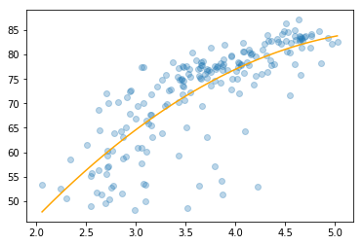
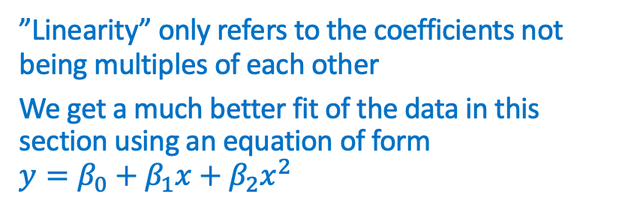
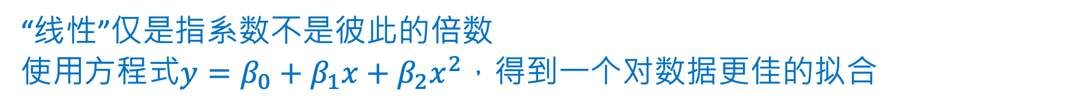
多项式回归 Polynomial regression
“线性”仅是指系数不是彼此的倍数
使用方程式$y=β_{0}+β_{1}x+β_{2}x^{2}$，得到一个对数据更佳的拟合
”Linearity” only refers to the coefficients not being multiples of each other
We get a much better fit of the data in this section using an equation of form $y=β_{0}+β_{1}x+β_{2}x^{2}$
Notes:
The linearity of our models depends on the linearity of $β_{n}$, not $x_{n}$. We will use this fact to use linear regression to model data that does not follow a straight line. Adding the polynomial term provides us with a much more intuitive fit of the data.

Slide 40
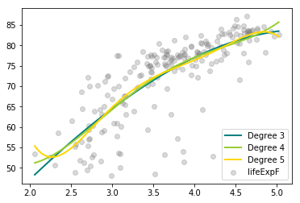
过拟合模型 Overfitting models
我们可以使用任意项的多项式
过多项会导致模型过于拟合训练数据，从而降低了在常规数据的性能
We can arbitrarily use many degrees in our polynomials
Too many degrees causes the model to fit the training data too closely, decreasing performance on general data
Notes:
Each additional polynomial degree improves the fit of our model. However, adding more degrees to the polynomial regressions opens us to the risk of overfitting, a process by which our models come to fit the training data too closely, and are thus less useful in predicting more generalized data.
Higher-degree polynomials also bring back the curse of dimensionality. Simple linear models need only $N+1$ sample points to fit, where $N$ is the number of dimensions (2 points in one dimension, 3 in two dimensions, 4 in three dimensions, and so on). However, each additional polynomial degree increases the number of sample points required for a given dimensionality much faster. Particularly if certain data points are difficult or expensive to come by, you might run out of data to fit a high-degree polynomial model.

Slide 41
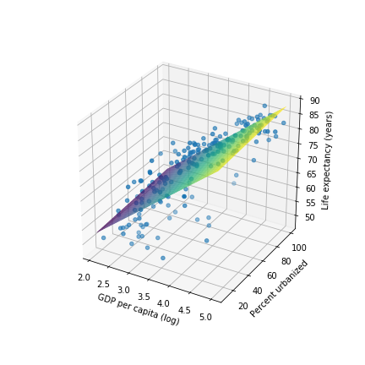
多重线性回归 Multiple regression
我们可以创建使用多个特征的模型
示例：方程式形式的模型
We can create models with more than one feature
An example is this model with equation of form
Notes:
Ultimately, no matter how complex the model we construct between two features, we will only be able to explain so much of variability because factors other than GDP affect the response. Using more than one predictor in our regression model helps us capture more of this richness of detail.

Slide 42
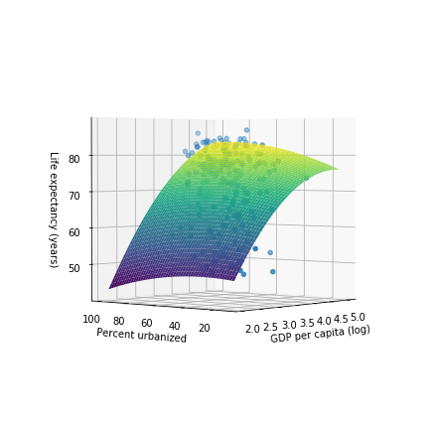
多重多项式回归 Multiple polynomial regression
我们可以将多项式函数应用于多个特征 也会出现相同的过拟合问题
We can apply polynomial functions to multiple features
The same problems with overfitting can also occur
Notes:
Each additional polynomial degree improves the fit of our model. However, adding more degrees to the polynomial regressions opens us to the risk of overfitting, a process by which our models come to fit the training data too closely, and are thus less useful in predicting more generalized data.
Higher-degree polynomials also bring back the curse of dimensionality. Simple linear models need only $N+1$ sample points to fit, where $N$ is the number of dimensions (2 points in one dimension, 3 in two dimensions, 4 in three dimensions, and so on). However, each additional polynomial degree increases the number of sample points required for a given dimensionality much faster. Particularly if certain data points are difficult or expensive to come by, you might run out of data in order to fit a high-degree polynomial model.

Slide 43
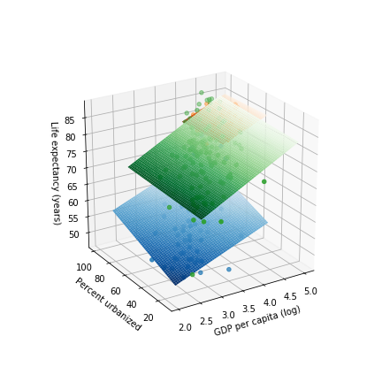
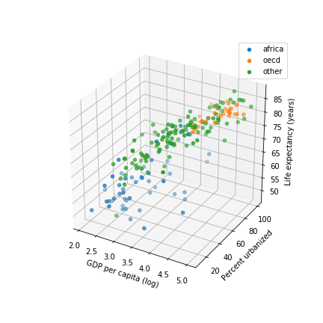
分类数据 Categorical data
并非所有数据都是数值，并且适合线性模型
处理此问题的一种方法是頗析每个类别的线性模型
Not all data is numeric and fits in linear models
One way to handle this is to examine linear models for each category
Notes:
Our dataset has two categorical features (also known as factors in the statistical world): region and group. There are multiple ways of handling data like this in linear regression; here, we will handle it by building sub-models for it.
Unsurprisingly, OECD-member countries cluster at the high end of the income scale and, sadly, African countries lag at the poorer end. Countries from the other group include countries ranging from poor ones in Southeast Asia to oil-rich Middle Eastern countries, and thus countries from that group are scattered across the income spectrum.
Now that we have the data points detailed in color, let's fit three separate, simple linear models for each group of countries. What do these plots based on group tell us? The slopes for log_ppgdp are similar between the africa and oecd groups, but the slope is different for the other group. This suggests that there might be some interaction between group and log_ppgdp in explaining lifeExpF. The pctUrban slope for the oecd group has a different sign than for africa or other, which might indicate another interaction, but we’re on shaky statistical ground here because we have done no testing to see whether these differences in slope are statistically significant (for pctUrban, the differences—and the numbers—are small).
What do we mean by interactions between groups? Recall that we generalized a linear model with two features as:
$$y=β_{0}+β_{1}x_{1}+β_{2}x_{2}$$
However, if $x_{1}$ and $x_{2}$ interact—if different values of $x_{1}$, for example, change the influence of $x_{2}$ on $y$—we need to include that in the model like so:
$$y=β_{0}+β_{1}x_{1}+β_{2}x_{2}+β_{3}{x_{1}x}_{2}$$
Our model involves three predictors (log_ppgdp, pctUrban, and group) and has this form:
$$y=β_{0}+β_{1}x_{1}+β_{2}x_{2}+β_{3}u_{2}+β_{4}u_{3}+β_{5}{x_{1}x}_{2}+β_{6}x_{1}u_{2}+β_{7}x_{1}u_{3}+β_{8}x_{2}u_{2}+β_{9}x_{2}u_{3}+β_{10}x_{1}{x_{2}u}_{2}+β_{11}x_{1}{x_{2}u}_{3}$$
Think of this as another aspect of the curse of dimensionality: as we add features (especially categorical ones), the number of potential interactions between features that we have to account for increases even faster.

Slide 44
https://aka.ms/ReactorFeedback

Slide 45
线性回归（第 2 部分） Linear regression (part 2)

Slide 46
第 2.2 节 综览 Section 2.2 Overview
Azure 机器学习工作室 交叉验证
独热编码
岭回归
Azure Machine Learning Studio
Cross validation
One-hot encoding
Ridge regression

Slide 47
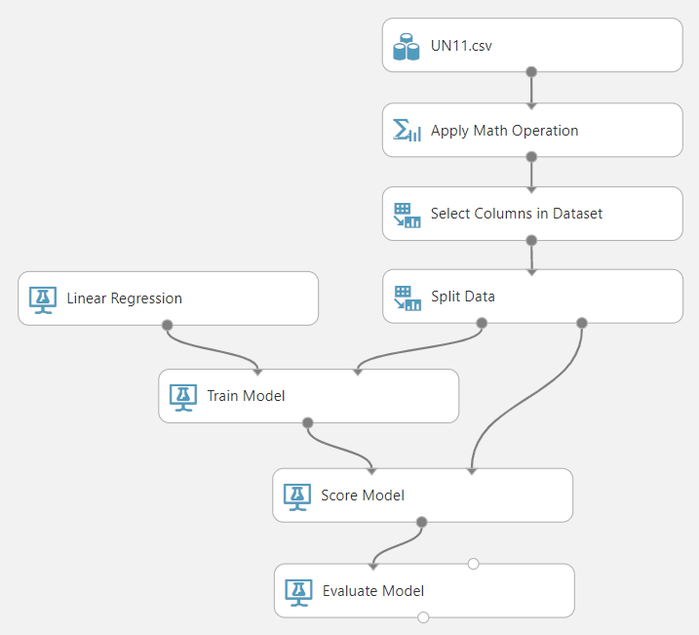
Azure 机器学习工作室 Azure Machine Learning Studio
拖放式图形用户界面(GUI)
在生产环境中，将训练好的模型发布为Web服务的自动化工具
Drag-and-drop GUI
Automates tools for publishing trained models as web services for use in production environments
Notes:
So far in this track, we have examined building and fitting ML models “locally.” True, the notebooks have been located in the cloud themselves, but the models with all of their predictive and classification power are stuck in those notebooks. To use these models, you would have to load data into your notebooks and get the results there.
In practice, we want those models to be accessible from a number of locations. And although the management of production ML models has a life cycle all its own, one part of that is making models accessible from the web. One way to do that is to develop them by using third-party cloud tools, such as Microsoft Azure ML Studio (not to be confused with Microsoft Azure Machine Learning Service, which provides end-to-end life-cycle management for ML models).
Alternatively, we can develop and deploy a function that can be accessed by other programs over the web—a web service—that runs within Azure ML Studio. Cloud-based ML-development tools like Azure ML Studio streamline the building, training, and deployment of machine learning models by providing a drag-and-drop interface and making a wide array of ML algorithms and tools readily available. Crucially, such tools simplify the deployment and management of ML models in production (not a focus of this course, but a major consideration in the real world).

Slide 48
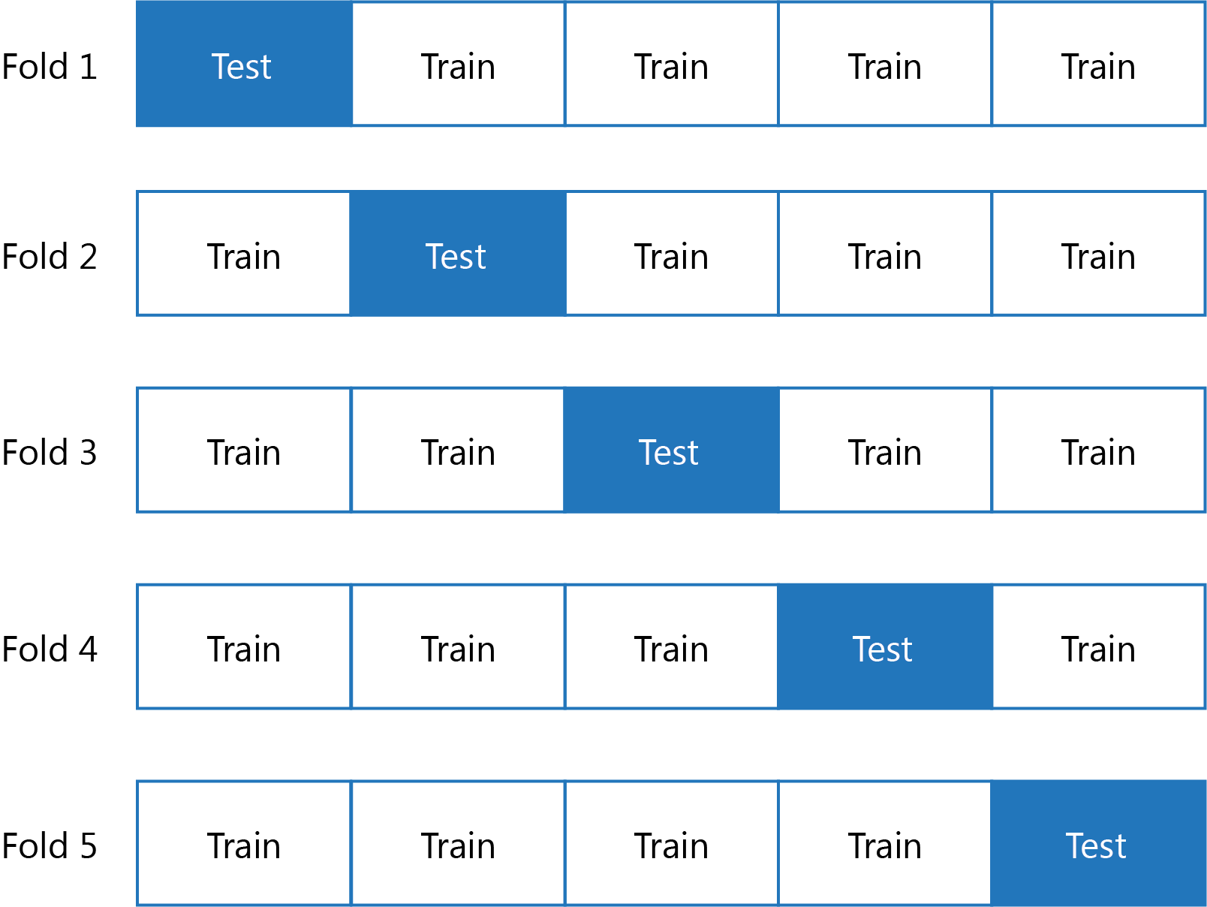
交叉验证 Cross validation
复数次随机地将数据集切分为训练集与测试集
帮助防止过拟合而不需要更多数据
确实增加了训练模型所需的计算时间
Randomly divides dataset into test and training subsets multiple times (folds)
Helps prevents overfitting while not requiring more data
Does add to computational time to train model
Notes:
The idea behind cross validation is that a single set of data is split multiple times between test and training data and is then evaluated. Each iteration of the splitting of this data is referred to as a “fold.” Using 10 folds to evaluate a model is ten-fold cross validation; more generally, data scientists speak of $k$-fold cross validation. The resulting score for a given model is the average of its performance against all of the different folds.
Cross validation can given you a more consistent picture of your model's performance again new data. This is important in production, but one tradeoff that comes with it is computational time: your model completes an entire run for each fold of your cross validation. For computationally intense models, including many folds in cross validation might not be feasible.

Slide 49
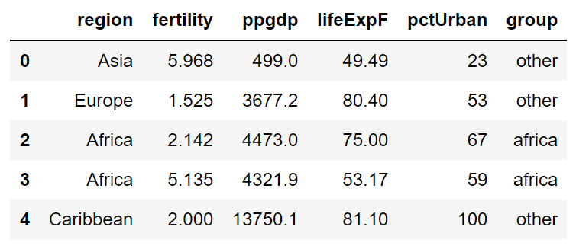
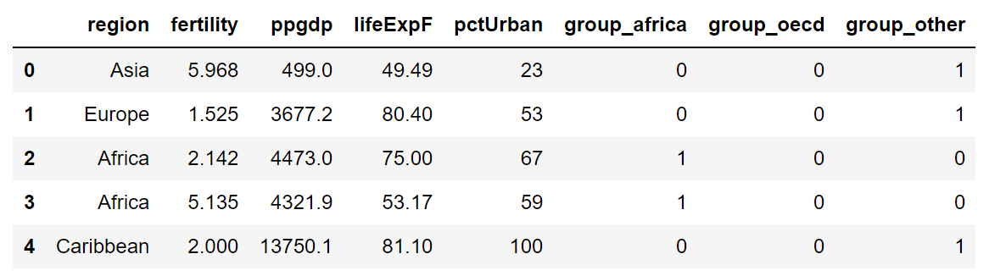
独热编码 One-hot encoding
将每一个类别项目转换为多个1或0构成的独立数值特征
Turns each categorical entry into a separate numeric feature with a value of 1 or 0
Notes:
Azure ML Studio uses a technique call one-hot encoding in which categorical features are assigned a state of 1 or 0 based on whether or not they are true. Thus, an OECD member country would have a value of 1 for the oecd value in group and 0s for africa and other. Another term for this is dummy variables.

Slide 50
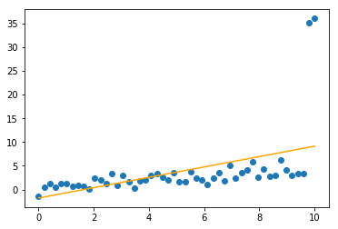
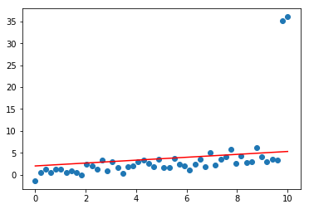
岭回归 Ridge regression
离群值会使回归线偏斜
岭回归 （L2正则化）可以帮助解决此问题
Outliers can skew the regression line
Ridge regression (also know as L2 regularization can help address this
无正则化
Without regularization
L2正则化
With L2 regularization
Notes:
Outliers in our training data—that is, data points that stray from the general clustering of other data points—are problematic because they skew our model while we are fitting it. The outliers have dragged the regression line on the left of the slide off of the cluster.
One way to address this is to add an additional weighted term to the ordinary least squares equation that we used to calculate our regression line. Tuning this weight parameter for this additional term will help our regression put less emphasis on the outlying points and greater emphasis on the well-clustered points. The specific technique we will use for this is called ridge regression (also referred to as L2 regularization).

Slide 51
进阶学习：机器学习和数据科学 Further Learning in Machine Learning and Data Science…
微软在云沙箱免费学习资源：
此研讨会内容的复习小伙伴 ： docs.microsoft.com/learn/paths/intro-to-ml-with-python/
更多关于数据科学方法和最佳习题的信息： docs.microsoft.com/learn/paths/explore-data-science-tools-in-azure/
開始构建 ML 模型： docs.microsoft.com/learn/paths/build-ai-solutions-with-azure-ml-service/
数据科学虚拟机实验： docs.microsoft.com/learn/paths/get-started-with-azure-dsvm/
了解更多Azure的功能： docs.microsoft.com/learn/paths/azure-fundamentals/

Slide 52

基于角色的微软证书：
在数据科学领域：
Azure 数据工程师副学士
Azure 数据科学家副学士
Azure 开发 人员副学士
此外…
Azure 基礎認證
Azure AI 工程师副学士

Slide 53
developer.microsoft.com/reactor/
@MSFTReactor on Twitter
Notes:
Thank you!

Slide 54
© 2019 Microsoft Corporation. All rights reserved. The text in this document is available under the Creative Commons Attribution 3.0 License, additional terms may apply. All other content contained in this document (including, without limitation, trademarks, logos, images, etc.) are not included within the Creative Commons license grant. This document does not provide you with any legal rights to any intellectual property in any Microsoft product. You may copy and use this document for your internal, reference purposes.
This document is provided "as-is." Information and views expressed in this document, including URL and other Internet Web site references, may change without notice. You bear the risk of using it. Some examples are for illustration only and are fictitious. No real association is intended or inferred. Microsoft makes no warranties, express or implied, with respect to the information provided here.

